Slide 1

ModelIt!
Student Lesson
Every Drop You Drink Is Recycled Dinosaur Water
The Never-Ending Journey of Water on Earth
NGSS: MS-ESS2-4
7th Grade
1/9

Slide 2
What You Will Learn Today
Learning Goals
* Model how solar energy drives the water cycle through evaporation and condensation
* Explain the role of gravity in precipitation and groundwater flow
* Predict how changing temperature affects water cycle rates and patterns
* Trace water through all phases and reservoirs in Earth's system
Key Vocabulary
Evaporation
When liquid water absorbs heat energy and transforms into water vapor gas
Condensation
When water vapor cools and transforms back into liquid water droplets, forming clouds
Transpiration
When plants release water vapor through tiny pores in their leaves
Watershed
An area of land where all water drains to a common outlet like a river, lake, or ocean
2/9

Slide 3
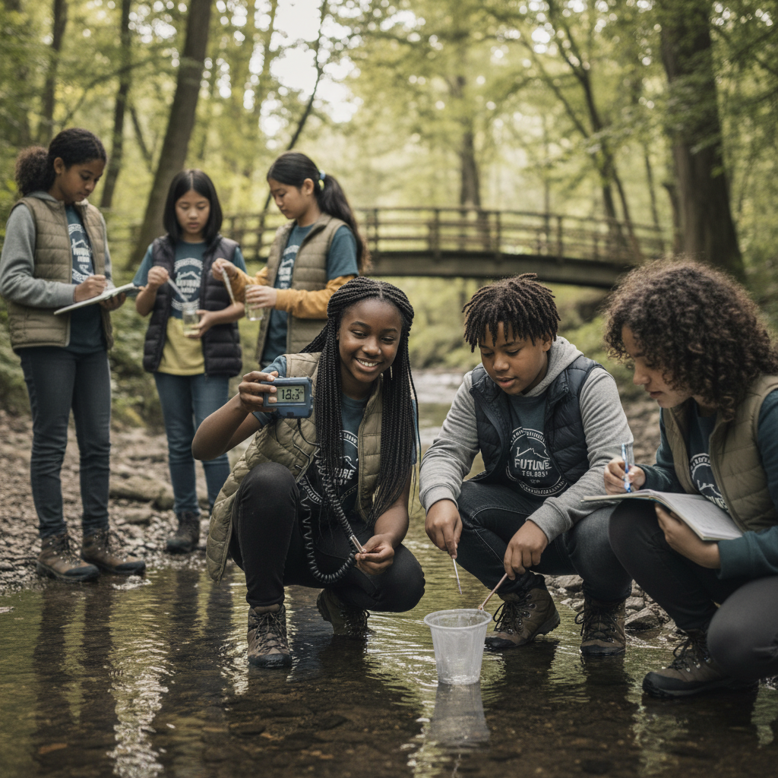
The Big Question
Why doesn't Earth ever run out of water if we use billions of gallons every day?
The Never-Ending Journey of Water on Earth. Today we'll build a MODEL to discover the answer!
3/9

Slide 4

Today We Will Build a Model!
A model helps us understand complex systems!
1. LOCATE
Identify the COMPONENTS (parts) of the system
2. ESTABLISH
Connect them with RELATIONSHIPS (+ or -)
3. VISUALIZE
Build your model in ModelIt!
4. EVALUATE
Run SIMULATIONS to test scenarios
5. REVISE
Improve your model based on evidence
4/9

Slide 5

Activity 1: Sort the Components
Sort these components into EXTERNAL (inputs from outside) and INTERNAL (inside the system):
Your Components:
* Solar Energy
* Ground Temperature
* Evaporation Rate
* Precipitation Rate
Think: Which components can we control? Which happen on their own?
5/9

Slide 6
Activity 2: Connect with Arrows
Draw arrows to show HOW components affect each other:
(+) POSITIVE Relationship
When one goes UP, the other goes UP too
(-) NEGATIVE Relationship
When one goes UP, the other goes DOWN
Think About It:
When solar energy increases dramatically (like during summer), what happens to the evaporation rate — and does more evaporation always mean more precipitation in the same area?
6/9

Slide 7
Activity 3: Run the Simulation!
Test these scenarios in ModelIt!
Summer Heat Wave
Set Solar Energy and Ground Temperature to maximum and observe water cycle rates
Winter Freeze
Lock Ground Temperature to near-freezing and observe how the cycle slows
Normal Conditions
Set moderate values for both inputs and observe the balanced cycle
Watch the activity graphs change!
[ModelIt Platform Screenshot - Simulation Results Graph]
7/9

Slide 8
What Did We Discover?
Our Model Showed Us:
* The Sun is the engine of the water cycle — without solar energy, water wouldn't evaporate
* Gravity pulls precipitation back to Earth and drives groundwater flow downhill
* The same water molecules have been cycling through Earth's systems for billions of years
* Temperature controls the SPEED of the cycle — hotter conditions accelerate it
Answer: Earth never runs out of water because it's continuously RECYCLED. Solar energy evaporates water from oceans and lakes, wind carries it as clouds, gravity pulls it back as rain, and it flows back to the ocean. The same water has been cycling for 4.5 billion years — every drop you drink was once a dinosaur's drink!
8/9

Slide 9
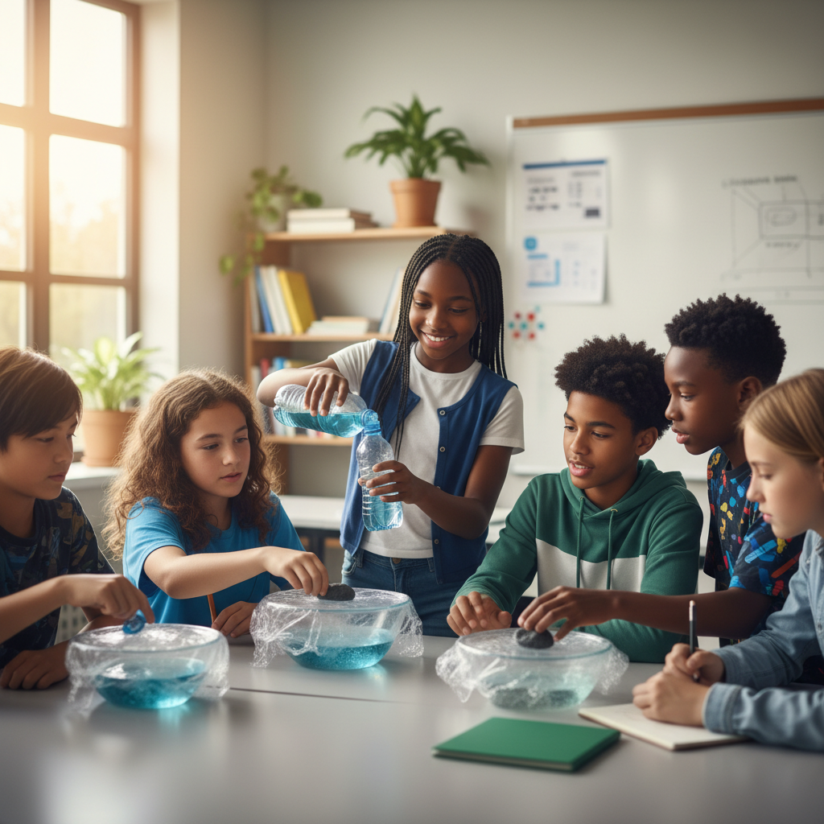
STEM Challenge: Design a Water Purification System
YOUR ENGINEERING MISSION
Engineer a portable water purification system using your understanding of the water cycle — specifically evaporation and condensation — to make dirty water drinkable.
The Challenge:
After a natural disaster, clean water supplies are contaminated. Your engineering team must design a solar-powered water purification system using water cycle principles to provide clean drinking water.
Think Like an Engineer:
* How can you use evaporation and condensation to separate clean water from contaminants?
* What role does solar energy play in your purification system?
* How would you scale your design to produce enough water for a family?
REAL CAREER CONNECTION: Hydrologists study the movement, distribution, and quality of water on Earth. They work for government agencies, environmental firms, and water utilities, earning $65,000–$110,000/year. The skills you're using TODAY are the same ones they use on the job!
9/9

